Slide 1
Lecture 13 Nested Sampling and MCMC in Astronomy
Lecturer: Dr Dominic Anstey (da401)
2024
MPhil in DIS - Data Driven Radio Astronomy in the SKA era
1

Slide 2
Overview
The importance in astronomy and cosmology
MCMC and Nested Sampling
Use of Bayesian data products
An example case – 21cm cosmology
Summary
2024
MPhil in DIS - Data Driven Radio Astronomy in the SKA era
1

Slide 3
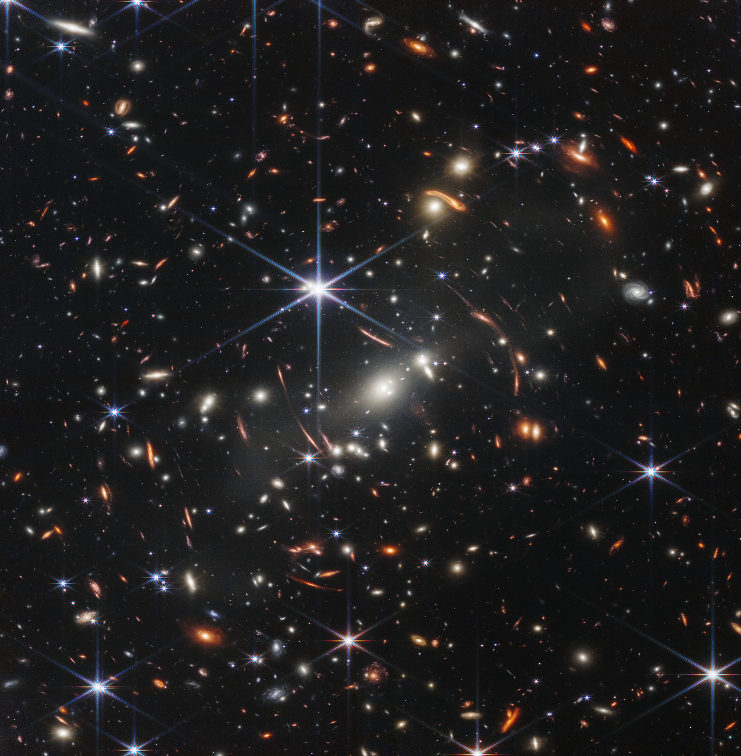
Importance in Astronomy
- Applicable to science in general
- Measuring individual, unchanging properties
- Often making individual measurements with individual instruments
MPhil in DIS - Data Driven Radio Astronomy in the SKA era
1

Slide 4
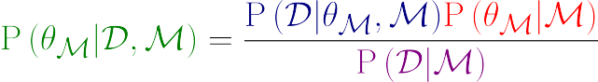
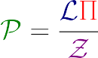
Bayes Theorem
Likelihood
Posterior
Prior
Evidence
MPhil in DIS - Data Driven Radio Astronomy in the SKA era
1

Slide 5
Bayesian Data Products
Inputs:
- Model
- Prior
- Likelihood
Products:
- Posterior
- Evidence
MPhil in DIS - Data Driven Radio Astronomy in the SKA era
1

Slide 6
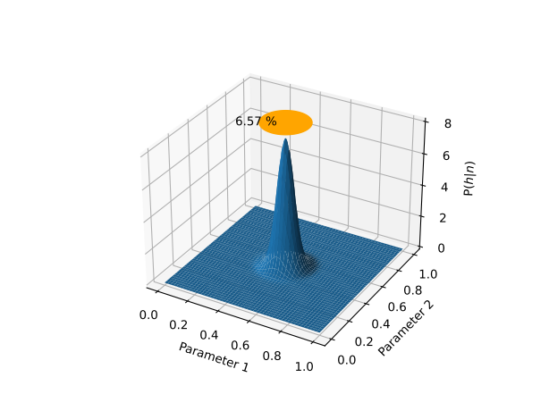
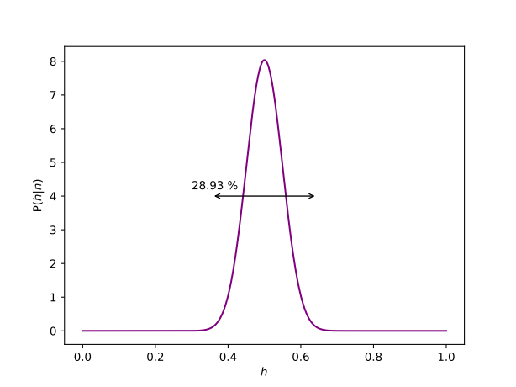
Posteriors and Parameter Estimation
Find the distribution of most probable parameter values given the data
Requires a mechanism for efficiently exploring the parameter space
MPhil in DIS - Data Driven Radio Astronomy in the SKA era
1

Slide 7
MCMC
Markov Chain:
Network of states with defined probabilities of moving between those states.
Two key features:
No part of the network is isolated from any other
Memoryless – the probabilities of moving to the next state depend only on the current state and not the steps taken to reach that state
MPhil in DIS - Data Driven Radio Astronomy in the SKA era
1

Slide 8
MCMC
Sampling a posterior through Markov Chain Monte Carlo Methods:
Define a Markov Chain with an underlying probability distribution matching the posterior probability distribution you want to evaluate
Perform one or more random walks (a Monte Carlo process) along the chain
After a burn-in period, the distributions of the walkers will approximate the underlying probability distribution
MPhil in DIS - Data Driven Radio Astronomy in the SKA era
1

Slide 9
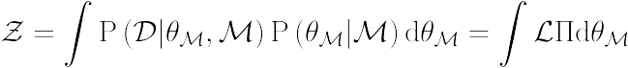
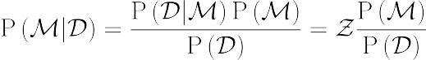
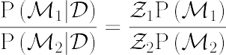
Evidence
The Bayesian Evidence allows the relative probabilities of different models to be compared
MPhil in DIS - Data Driven Radio Astronomy in the SKA era
1

Slide 10
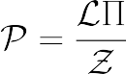
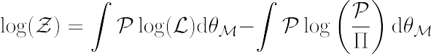
Occam Penalty
Expectation of log likelihood over posterior distribution – quantifies the quality of the model fit
Ratio of posterior to prior – increases as finite prior probability is spread over a wider area
For two models that produce equally good fits, the one with more parameters will give a lower evidence: Bayesian evidence comparison naturally implements Occam’s Razor
MPhil in DIS - Data Driven Radio Astronomy in the SKA era
1

Slide 11
The Curse of Dimensionality
1000 likelihood evaluations
1,000,000 likelihood evaluations
MPhil in DIS - Data Driven Radio Astronomy in the SKA era
1

Slide 12
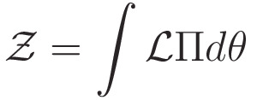
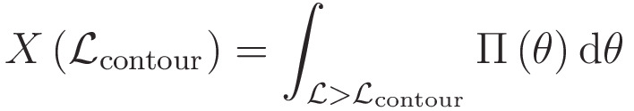
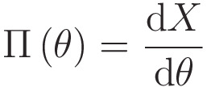
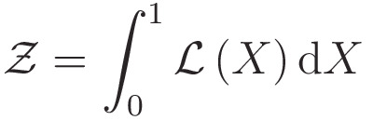
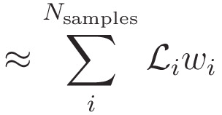
Nested Sampling
Aims to calculate the Bayesian Evidence:
Need to reduce dimensions
Define a new quantity – the fraction of the prior volume contained with in a contour of constant likelihood
The prior is the gradient of this value with respect to the parameters
Substitute this definition of the prior into the evidence calculation. Reduces the evidence calculation to a 1D integral
MPhil in DIS - Data Driven Radio Astronomy in the SKA era
1

Slide 13
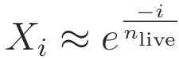
Nested Sampling
Draw a number of samples from the prior and calculate the likelihood of all of them
Identify the lowest likelihood point
Draw a new point from the prior distribution, subject to the constraint that its likelihood is higher than the identified lowest point
Replace the old lowest likelihood point with the new one
Repeat until the samples converge
The discarded dead points are ordered in likelihood and uniformly spaced in log(X), as required
Final live point distribution gives the posterior as a side product
x
x
x
x
x
x
x
x
x
x
x
x
x
x
MPhil in DIS - Data Driven Radio Astronomy in the SKA era
1

Slide 14
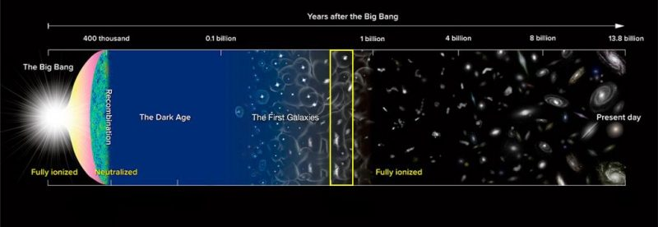
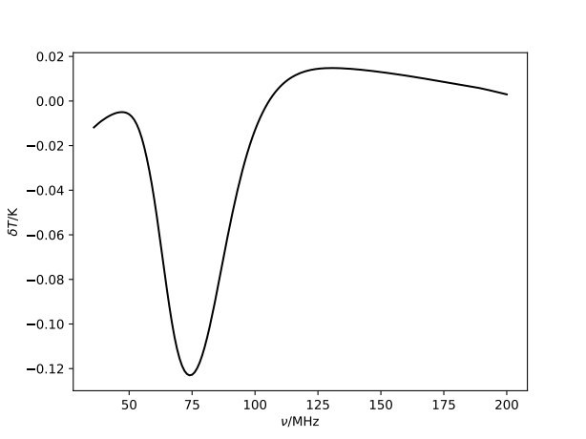
Use Case – 21cm Cosmology
MPhil in DIS - Data Driven Radio Astronomy in the SKA era
1

Slide 15
Dark Ages and Cosmic Dawn
MPhil in DIS - Data Driven Radio Astronomy in the SKA era
1

Slide 16
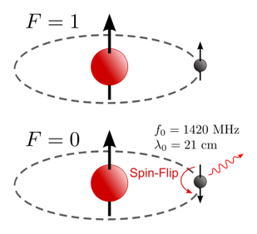
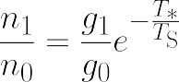
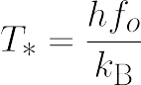
Spin Temperature
https://en.wikipedia.org/wiki/Hydrogen_line
MPhil in DIS - Data Driven Radio Astronomy in the SKA era
1

Slide 17





21cm Signal
MPhil in DIS - Data Driven Radio Astronomy in the SKA era
1

Slide 18
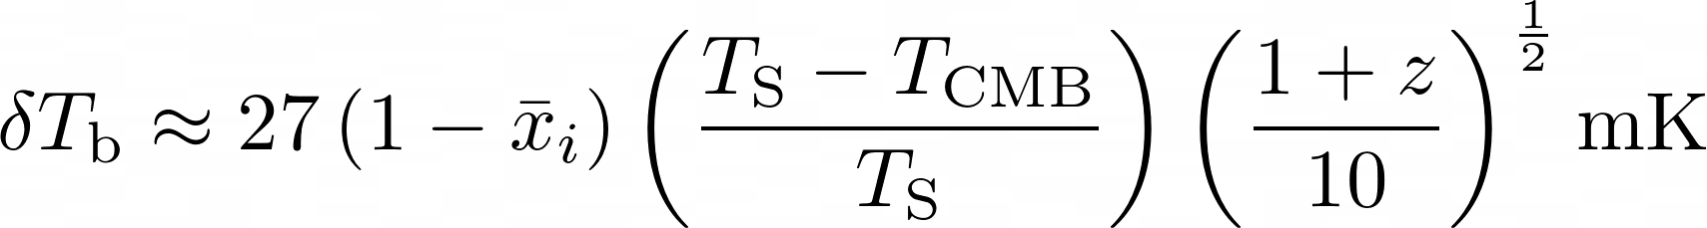
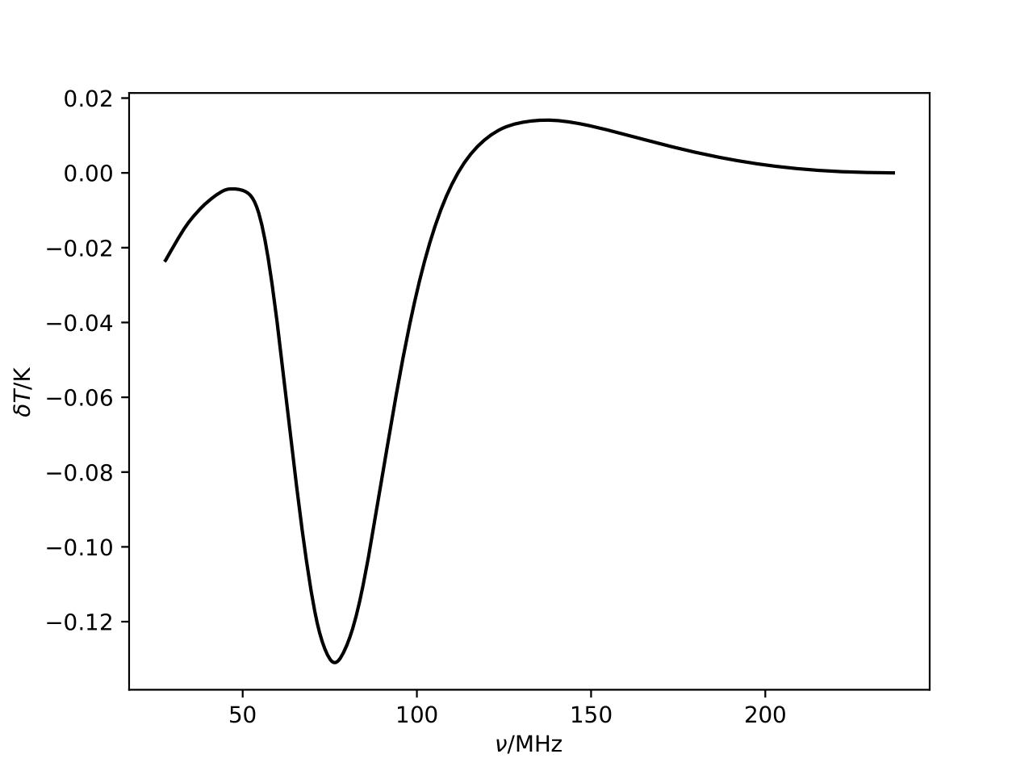
21cm Signal
Effects that alter Spin Temperature:
- Collisions
- Lyman-alpha photons
- Ionising UV photons
First Stars
Reionisation
Heating
Dark Ages
MPhil in DIS - Data Driven Radio Astronomy in the SKA era
1

Slide 19
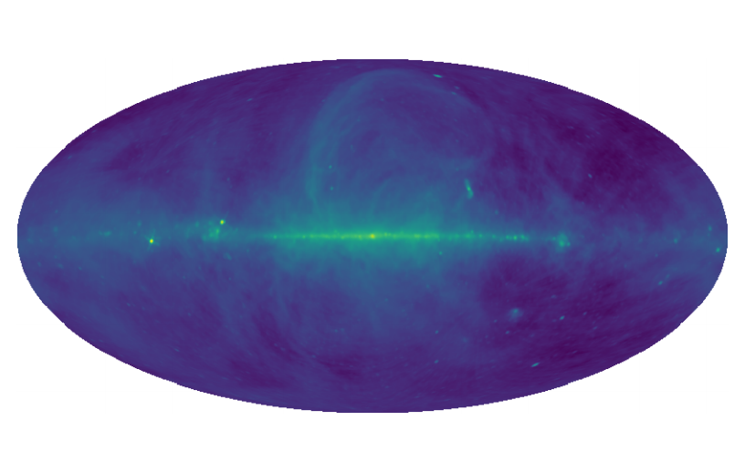
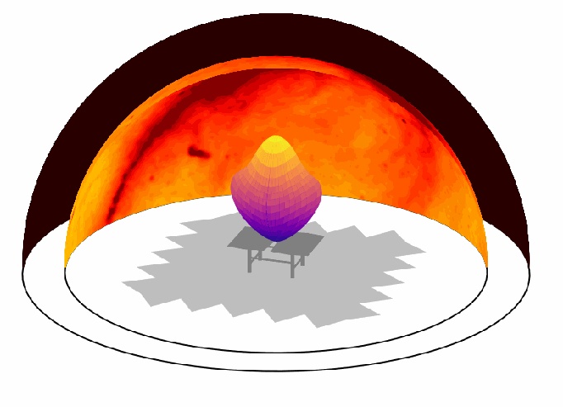
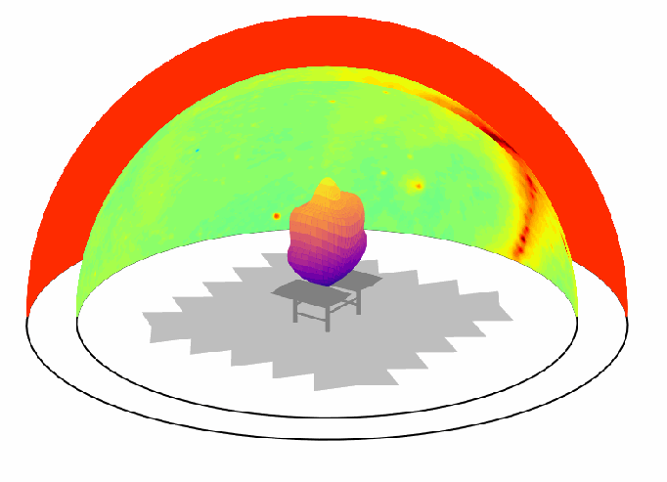
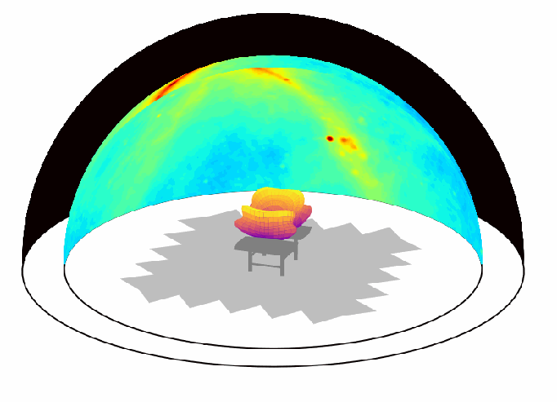
Foregrounds and Systematics
Galactic and extragalactic radio emissions
MPhil in DIS - Data Driven Radio Astronomy in the SKA era
1

Slide 20
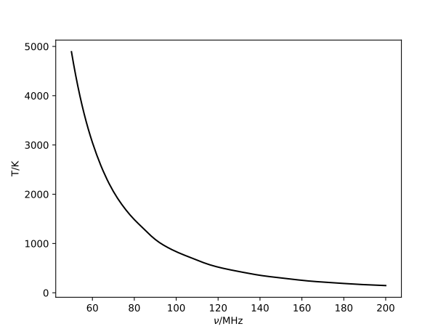
21cm Data
MPhil in DIS - Data Driven Radio Astronomy in the SKA era
1

Slide 21
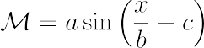
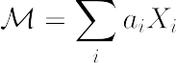
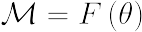
Define a Model
Requirements for your model:
- Includes truth within parameter space
- Able to account for expected uncertainties
- Minimal degeneracies with other components
Analytical models
Linear Models
Forward Models
- Fast to compute
- Well constrained
- Do not exist for all problems
- Fast to compute
- Very general
- Can become very high dimensional
- Often not constrained
- Specific to problem
- Well constrained
- Slow to compute
- Machine Learning
MPhil in DIS - Data Driven Radio Astronomy in the SKA era
1

Slide 22
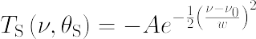
Define a Model
Analytical Model
MPhil in DIS - Data Driven Radio Astronomy in the SKA era
1

Slide 23
Define a Model
Forward Model
MPhil in DIS - Data Driven Radio Astronomy in the SKA era
1

Slide 24
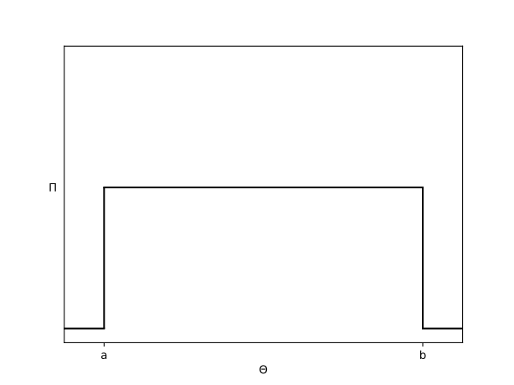
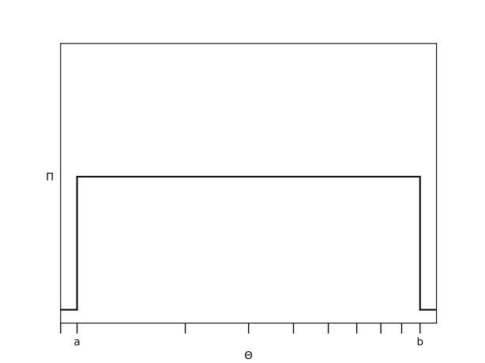
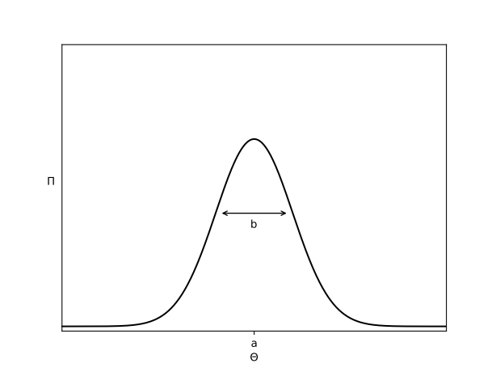
Define a Prior
Requirements for your prior:
- Includes the truth within the parameter space
- Accurately reflects existing knowledge
Uniform priors
- Known limits
Log-Uniform priors
- Known limits across orders of magnitude
Gaussian priors
- Known expectation and uncertainty
Any other probability distribution
- Correlations
- Conditions
- Normalising flows
- etc.
MPhil in DIS - Data Driven Radio Astronomy in the SKA era
1

Slide 25
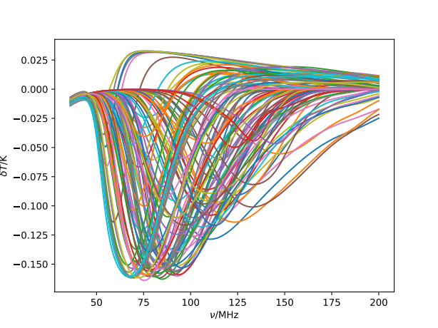
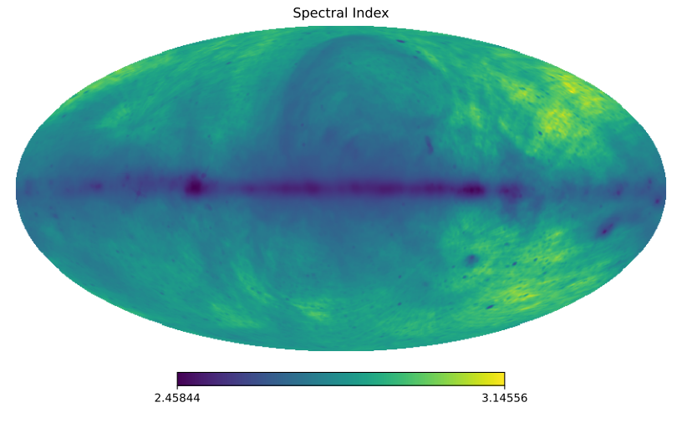
Define a Prior
MPhil in DIS - Data Driven Radio Astronomy in the SKA era
1

Slide 26
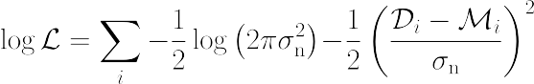
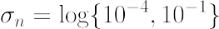
Define a Likelihood
Probability of observing data, given a model
Usually describes noise structure
See lecture 16 for what to do if you cannot define a likelihood
MPhil in DIS - Data Driven Radio Astronomy in the SKA era
1

Slide 27
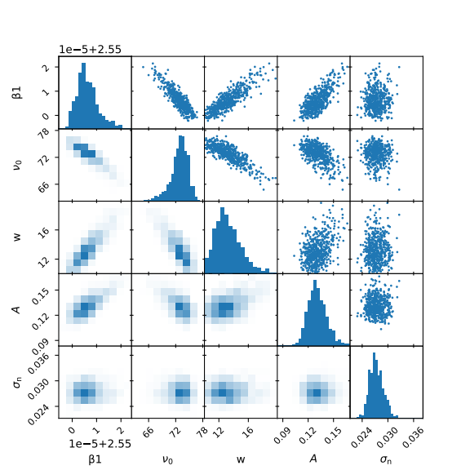
Data Products
Nested Sampling using PolyChord (Handley et al. 2015)
MPhil in DIS - Data Driven Radio Astronomy in the SKA era
1

Slide 28
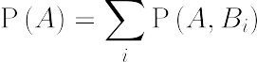
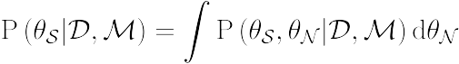
Marginalising Nuisance Parameters
Marginalisation removes posterior dependence on uninteresting parameters, accounting for all values they can take and how probable those values are
MPhil in DIS - Data Driven Radio Astronomy in the SKA era
1

Slide 29
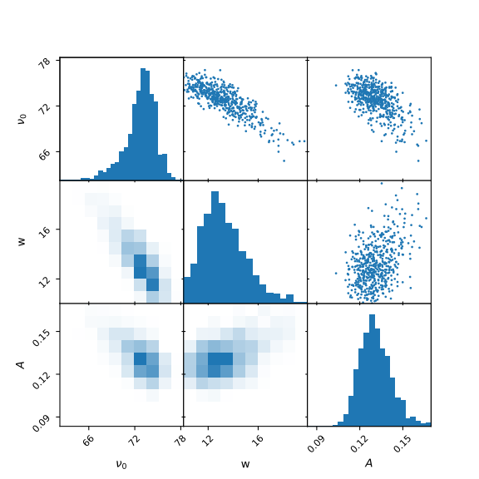
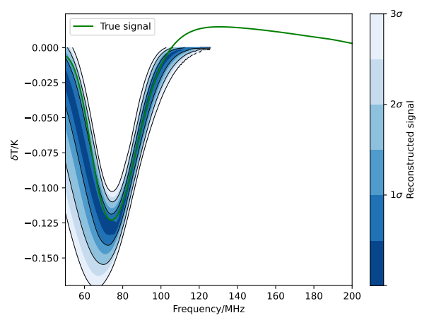
Marginalising Nuisance Parameters
MPhil in DIS - Data Driven Radio Astronomy in the SKA era
1

Slide 30
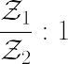
Model Comparison
Preferential betting odds of model 1 in comparison to model 2 are
Provided the same data set is used for both
MPhil in DIS - Data Driven Radio Astronomy in the SKA era
1

Slide 31
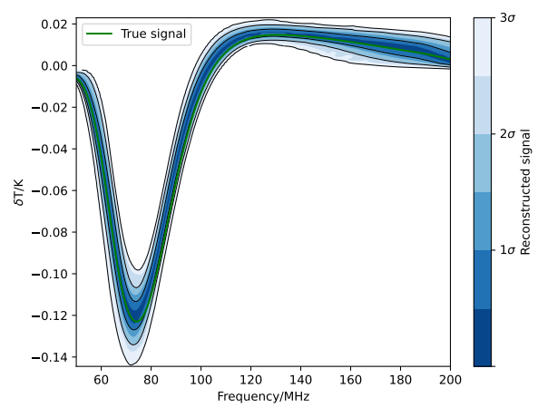
Model Comparison
Consider, instead of analytical Gaussian signal model, we use a neural net train to simulate realistic signals from physical properties (lecture 15 will cover this more)
Fit both models and compare evidence
MPhil in DIS - Data Driven Radio Astronomy in the SKA era
1

Slide 32
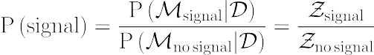
Model Confidence
How confident can you be that you have detected the signal you are looking for?
Fit the same data set with another model in which everything is identical except that the component of interest has been removed
MPhil in DIS - Data Driven Radio Astronomy in the SKA era
1

Slide 33
Model Optimisation
Consider a case where our model cannot exactly match the data to within noise
MPhil in DIS - Data Driven Radio Astronomy in the SKA era
1

Slide 34
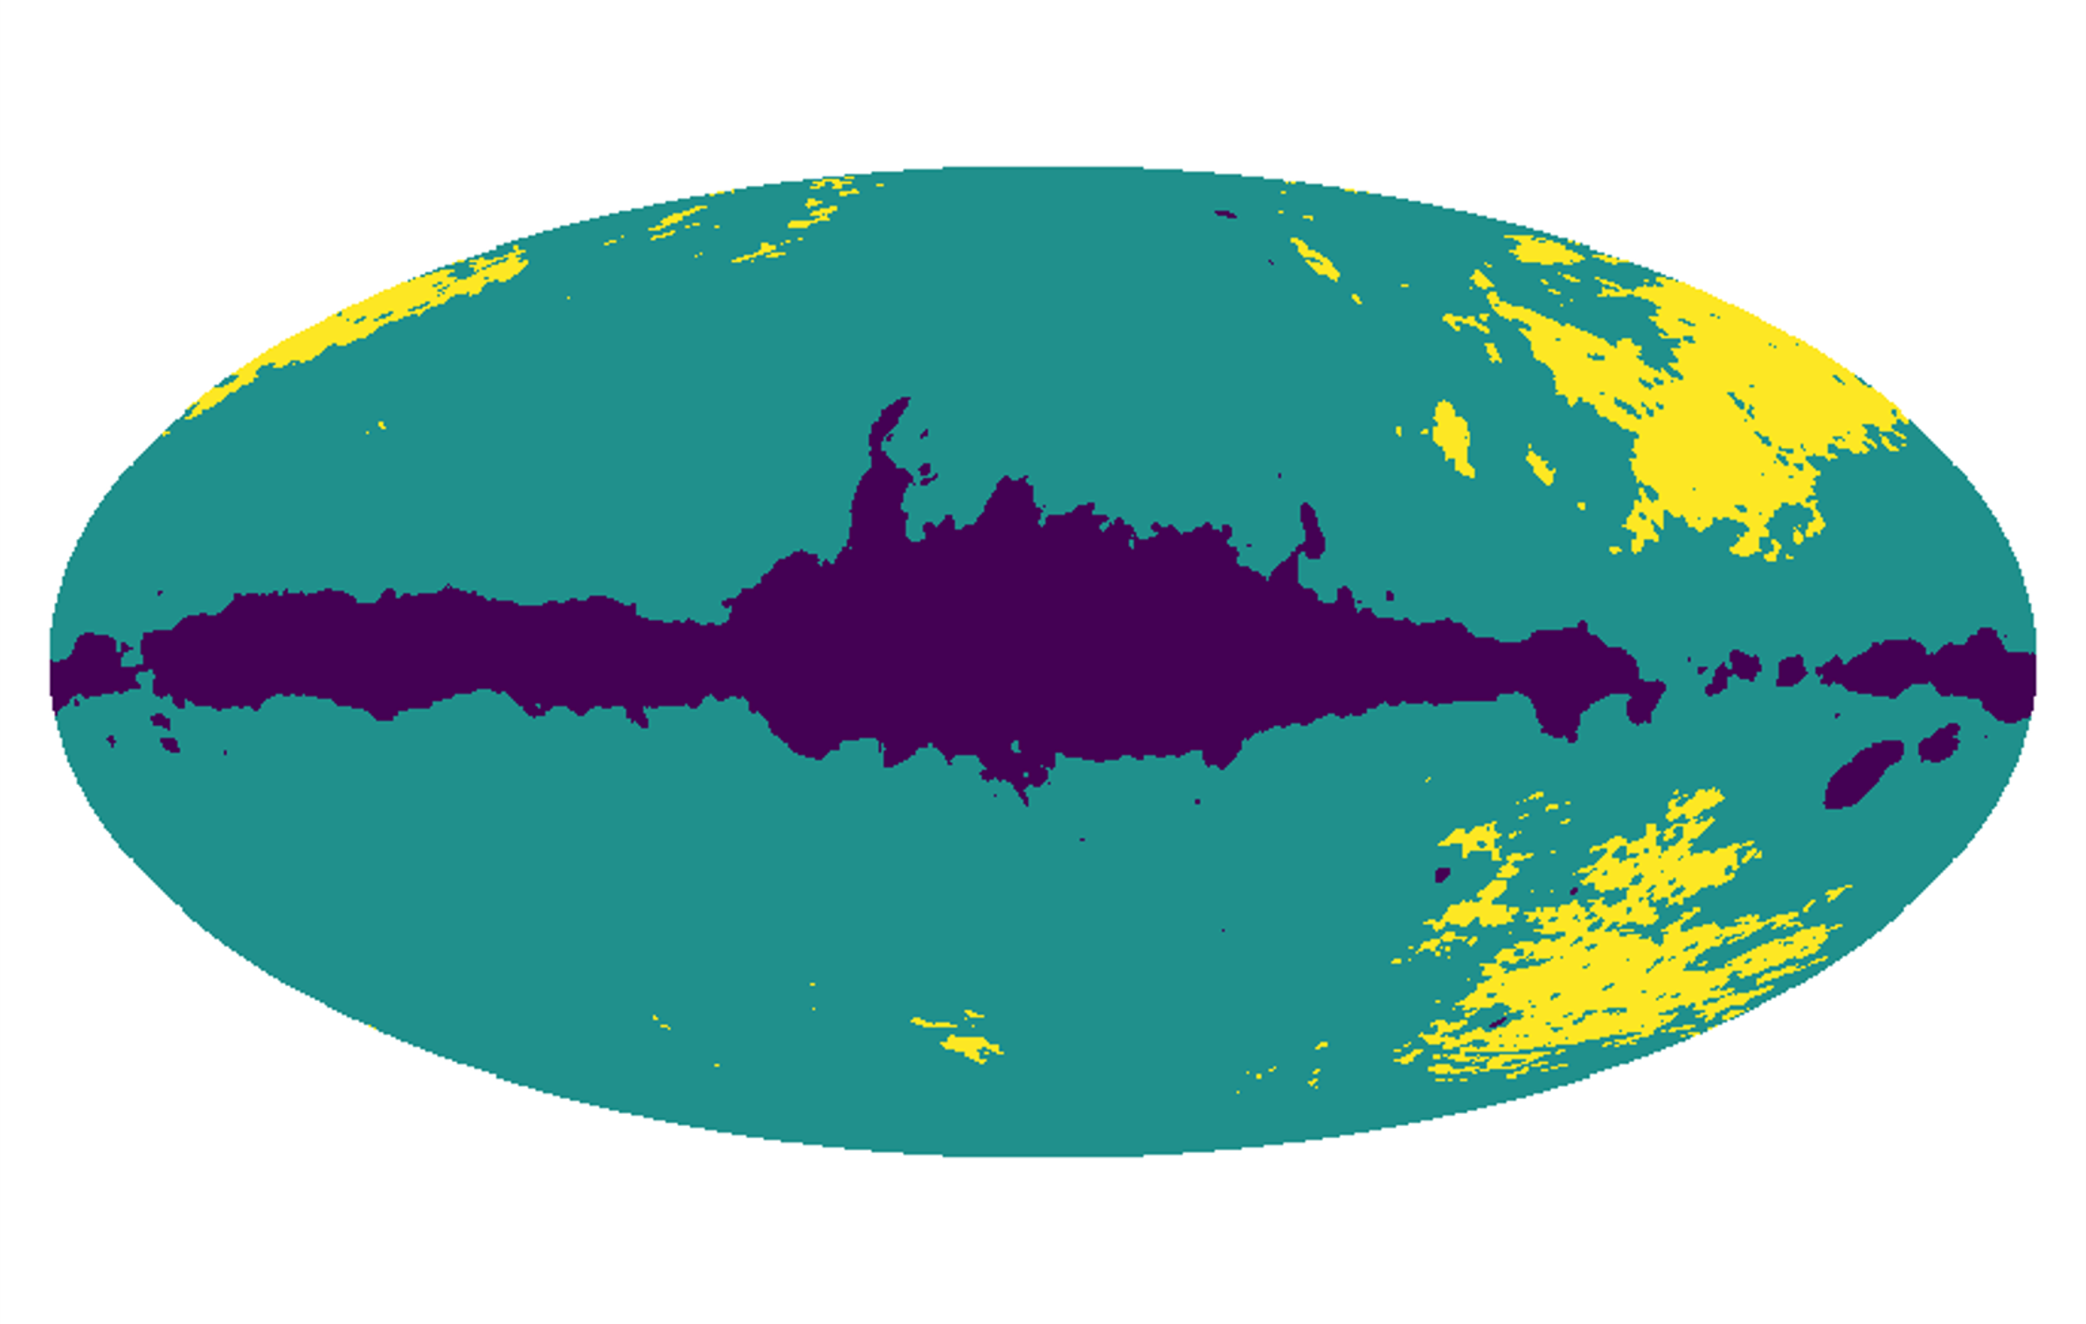
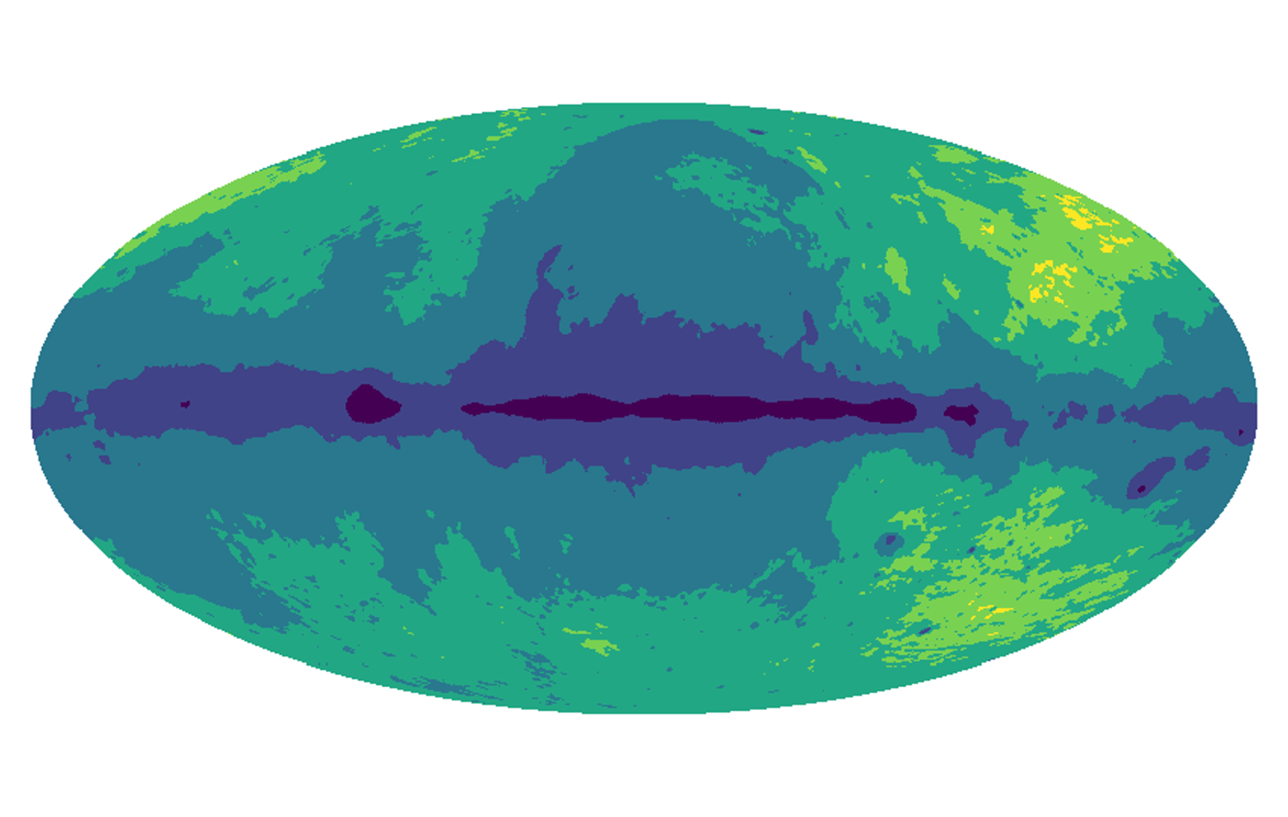
Model Optimisation
Parametrise by spectral index
3 Regions
6 Regions
β₆
β₅
β₃
β₄
β₂
β₃
β₁
β₂
β₁
How many parameters/how complex a model should be used?
MPhil in DIS - Data Driven Radio Astronomy in the SKA era
1

Slide 35
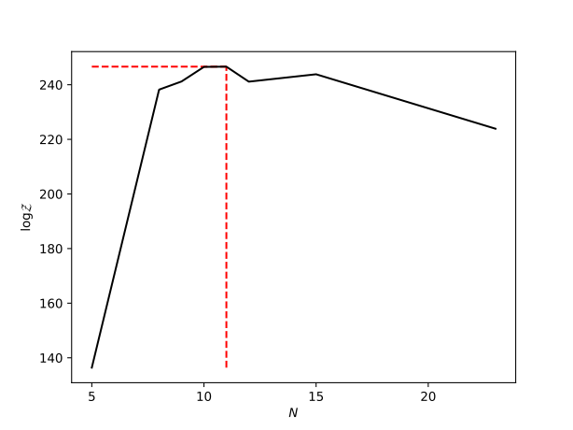
Model Optimisation
Models that give better fits to the data give a higher Bayesian evidence, but additional parameters in the model that do not improve the fit are penalised in the Bayesian evidence
Improving fit
Occam Penalty
MPhil in DIS - Data Driven Radio Astronomy in the SKA era
1

Slide 36
Summary
Recaped MCMC and Nested Sampling and their respective uses
Learnt the basics of 21cm cosmology
Discussed how to define models, priors and likelihoods in practice
Covered how to used Bayesian data products to interpret results:
- Marginalising nuisance parameters
- Comparing different models
- Optimising inexact models
- Quantifying confidences in results
2024
MPhil in DIS - Data Driven Radio Astronomy in the SKA era
<number>

